Slide 1
Computer Architecture Concepts
Part 20 – Syscalls for user input

Slide 2
Objectives
So far, we have seen how to output integers, characters and strings
We check on the syscall help
We put the relevant code in register $v0
We put other information needed in register $a0
In this part we look at how to receive user input of an integer or a character

Slide 3
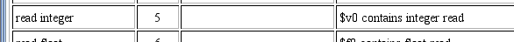
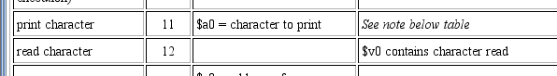
Reading in an integer or char
Store the relevant service code in $v0
Do the syscall
When the user has pressed enter the input will be in $v0
We are not covering exceptions on this unit
You would need to move that data from $v0 to another register

Slide 4
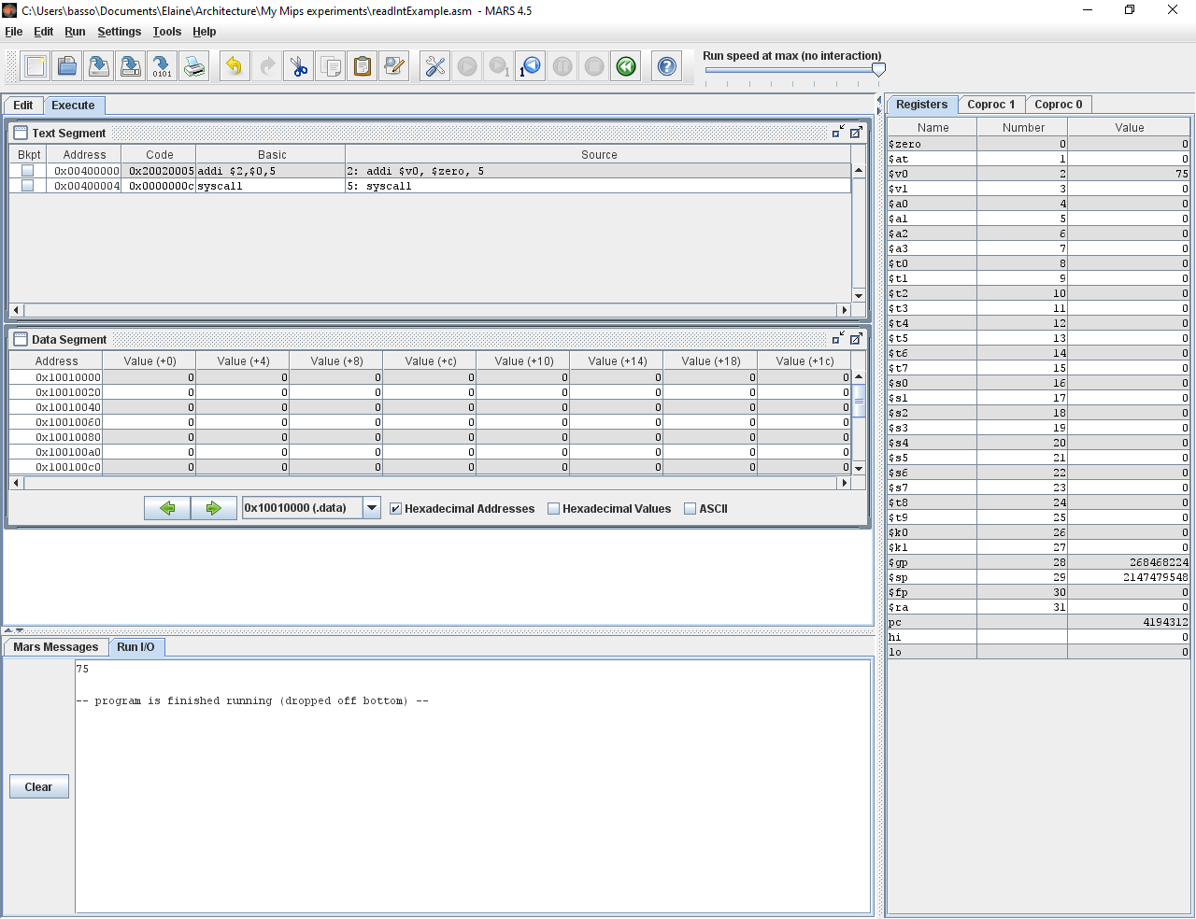
Read in an Integer
# Put 5 into $v0
addi $v0, $zero, 5
# Pass control to OS
syscall

Slide 5

Read in a Character
# Put 12 into $v0
addi $v0, $zero, 12
# Pass control to OS
syscall

Slide 6
Summary
To read in an integer or a character we use syscalls in a similar way to we did for output
Note, we do not cover exception handling on this unit

